Slide 1
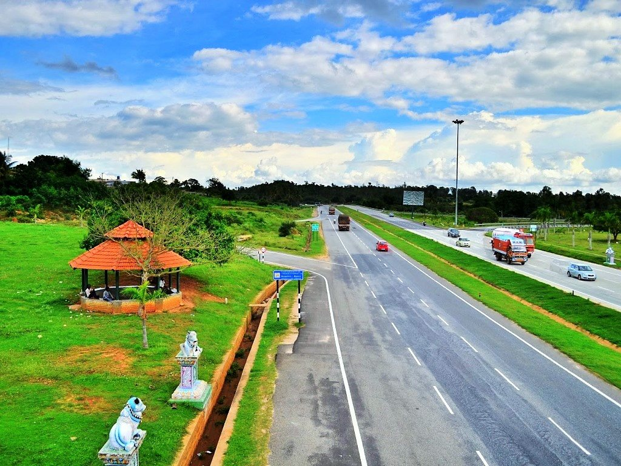
Project Title:
RTO Management System

Slide 2

INDEX
1.Introduction
1.1 Objective
1.2 Scope of the project
1.3 Hardware Interfaces
1.4 Software Interface
1.5 Communication Interface
1.6 Programming Language
1.7 User Interface
1.8 Assumptions and Dependencies
1.9 References
1.10 Project modules
1.11 Security Requirements
1.12 Future scope of the project
1.13 Software Quality Attributes
1.14 Definitions, Acronyms, Abbreviations
1.15 Overall Description
2.0 SYSTEM DESIGN
2.0.1 Context Flow Diagram (CFD)
2. Data Flow Diagram
2.1 DFD Level
2.2 DFD Level
2.3 DFD Level
2.4 DFD Level
2.5 DFD Level
2.6 DFD Level
2.7 DFD Level

Slide 3
INDEX
3. Data Base Design
3.1. Introduction
3.2 The Database
3.3 Each entity and Attributes
3.4. Entity-Relationship Diagram
4. DETAIL DESIGN
4.1 Modular Decomposition of Components
5.Detail Design
5.1. Introduction
5.2. Applicable Documents
5.3. Structure of the software package
5.4. The project modules
6.Conclusion

Slide 4

Project Title:
RTO Management System
1.Introduction
The Regional Transport Office (RTO) or Regional Transport Authority (RTA) is the organisation of the Indian government responsible for maintaining a database of drivers and a database of vehicles for various states of India.
The Objective of RTO management system is to provide a online tool for the ease of RTO functions such as vehicle registration, Learner license, permanent license, renewal of license, and many more.
1.1 Objective
This web application helps for RTO office employees as well as citizens of India. It will reduce considerably the difficulties faced on existing system, with minimum error and difficulties.
The RTO employees having lot of work burden of making registration, License issue, transfer, etc., which required lot of paper work.

Slide 5

1.2 Scope of the project
The project has following features:
This project works online which helps RTO office employees and Indian citizens.
The System keeps track of the transactions in the RTO office.
It maintains Renewal of Online LLR Form, Registration Form, Issue of permanent license, learner’s License, Renewal of permanent license, Issue of learner’s license, payment against challan and finally it produce printouts to payment of customers.
This project prepared RTO office to maintain all the records like issuing the LL, DL, Vehicle registration, Vehicle ownership transfer etc. This will automate the process of registration of vehicle and issuing driving license process.
System helps user to find their vehicle Information through online.
1.3 Hardware Interfaces
Operating system: Windows XP / Windows 7
Hard disk: 40 GB hard disk
RAM : 1 GB RAM
Processor: Intel Pentium or above

Slide 6


1.4 Software Interface
XAMPP 1.8.2
Apache server
PHP 5.4
MYSQL server 5.5
Notepad++
1.5 Communication Interface
The project shall use the HTTP protocol for communication over the internet and for the intranet communication will be through TCP/IP protocol suite.
1.6 Programming Language
Front End: PHP
Back End: MySQL

Slide 7

1.7 User Interface
The major user classes that are expected to use this product are as follows:
Administrator:
Administrator is a super user treated as owner of this site. He can have all the
privileges.
Administrator managing completed features of the website. Admin can approve
driving license, vehicle registrations, etc. Administrator can add employees for
each branches.
Employee:
Employees are working for RTO Company who verifies user profile.
User:
Users are citizens of India who can apply for LLR, permanent license,
learner’s License, Renewal of permanent license, Issue of learner’s license

Slide 8


1.8 Assumptions and Dependencies
Internet connection required.
24X7 uptime server connection required.
One assumption about the product is that it will always be used on mobile phones that have enough performance.
The user should have basic computer knowledge. They should be trained to handle the features provided by the system.
The browser version should be used which have html5 support
  1.9 References
Books:
    Software engineering by Pankaj Jalote.
    Learning PHP, MySQL, JavaScript and CSS: A Step-by-Step Guide to Creating Dynamic Websites by Robin Nixon.
Website:
    www.w3schools.com
    www.tutorialspoint.com

Slide 9

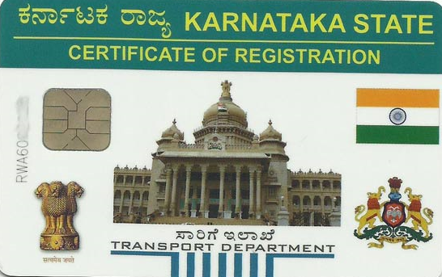
1.10 Project modules
The project has following modules:
Admin Account module: Administrator is the main user of the project. He has the power to verify the data entered by RTO officials.
  Add employees
  View employees
  Add branch
  View branch
  Verification of DL, LLR, Vehicle registration
RTO officer account module: This module is for RTO officers to manage the user applications. Administrator is adding RTO official details. RTO officials do following task:
  Registration of vehicle
  Providing number for vehicle
  Issue of information's about driving license.
  Renewal of license
  and many more

Slide 10
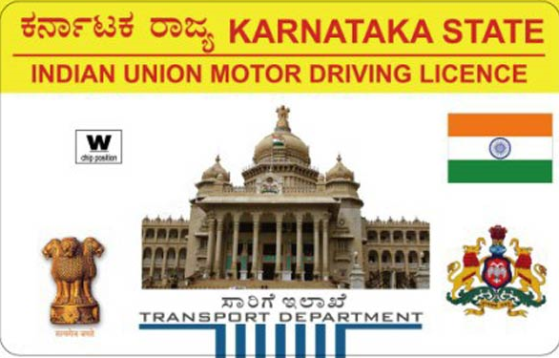
User account module: This module allows user to register through online by entering profile details. After the successful registration the user can login to the system by entering login id and password.
  User registration module
  User login module
Vehicle registration module: The module allows user to apply new registration of vehicles. Even this module allows to send vehicle transfer request.
  Vehicle registration module
  Vehicle transfer module
Online License Application module: This module allows users to apply for Learner license, permanent license, changing the address of license, renew the license. RTO officials can verify and approve/reject received applications.
  Learner license module
  Permanent license module
  Address modification module
  License renewal module

Slide 11

Branch module: This module allows user to add RTO branch details by entering branch name, branch description, etc.
  Add branch
  View branch
Report module: This module generates various kinds of reports.
  Registration report
  Vehicle registration report
  Learner license report
  Permanent license report
  Address modification report
  License renewal report

Slide 12

1.11 Security Requirements
Users shall be required to log in to the System for all operations
except viewing a items.
The system shall permit only staff members who are on the list of
authorized Menu Managers to create or edit items.
1.12 Future scope of the project
We can also add a provision to track a stolen vehicle in the future systems through GPS tracking.
Fake registration plates, if any, would be detected immediately.
We can implement this project in Android or iPhone in future
1.13 Software Quality Attributes
      Reliability
      Security
      Maintainability
      Availability
      Portability

Slide 13

1.14 Definitions, Acronyms, Abbreviations
SRS – Software requirements specifications.
PHP - A server side scripting language.
MySQL - The database that will be used for this project.
http – Hypertext transfer protocol
www – World wide web
RTO - Regional Transport Office
1.15 Overall Description
The following subsections provide complete overview of the Documentation
for the product “RTO Management system”. For the rest of the document,
we first define the overall product. Then, we give the external interface
requirements, followed by a brief description of the product components and
features. In the last section, we have provided the non-functional requirements of
the product. This Time we are presenting the Product.

Slide 14
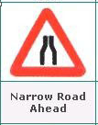
2.0 SYSTEM DESIGN
System design is a primary phase of the software development. System design aims to identify the modules that should be in the system.
This document is the design report for an online Regional Transport Office management System (RTOSYS). This is mainly about ‘how to do’ and will help provide an insight to the whole system design and implementation of the online Regional Transport Office system.
This software has the following three main components:
Implementation of different type of users- Administrator, Users, RTO staff.
Management of vehicle information along with the violations of the vehicle.
Implement complaint option for users. The user can lodge a complaint on a particular accident or traffic violations.
With the help of this website the registered user can use the services provided which include application for learner license, registration of vehicles, fee payment.

Slide 15

2.0.1 Context Flow Diagram (CFD)
A context Flow diagram (CFD) in software engineering and systems engineering is a diagram that defines the boundary between the systems, or part of a system, and its environment, showing the entities that interact with it. This diagram is a high-level view of a system. It is similar to a block diagram.

Slide 16

2. Data Flow Diagram
A Data flow diagram is a graphical representation of the data flow of a particular information system. A data flow diagram can also be used for the visualization for the data processing. It is common practice for the designer to draw a context level DFD. It shows the interactive between the system and the outside entities. The context level DFD, is then exploded to show more detailed of the system being modelled
A DFD represents flow of data of a system. Data flow diagrams are commonly used during problem analysis. It views as a function that performs the input into the desired output. DFD shows movement of data through the different transformations or processes in the system.

Slide 17
Top-level DFD

Slide 18
2.1 DFD Level
This level used to add RTO official record. First the admin needs to add all state records which stores in state table. Then admin needs to add city table which stores in city table. To add branch record admin needs to select state and city record. After adding branch record branch detail stores in branch table.

Slide 19
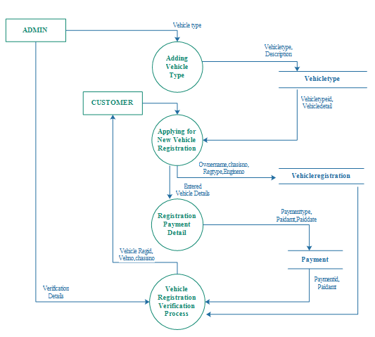
2.2 DFD Level
This process explains how the vehicle type detail and vehicle registration detail stores in the database. Admin needs to add vehicle type and those detail stores in vehicletype table. From the customer end customer will apply for new vehicle registration. Entered vehicle detail stores in vehicleregistration table

Slide 20
2.3 DFD Level
This module is registration module which helps to register to user through online. user needs to enter registration details by entering name, Email ID, password, contactno. Registration detail stores in user table. After the registration user can login to the website by entering emailid and password in the login process. The registration detail verifies from user table

Slide 21
2.4 DFD Level
This process will explain how the Learning license application works in our project. First user needs to apply for learning license. After applying learning license those detail stores in llr table. After entering detail, the user needs to pay for learning license. From the employee end employee needs to take test to approve learning license. The test detail stores in test table.

Slide 22
2.5 DFD Level
This process will explain how the Driving license feature works and how user can apply for driving license. First user needs to apply for Driving license and application detail stores in driving­_license table. After entering detail, the user needs to pay for Driving license and payment detail stores in payment table. From the employee end employee needs to take test for driving license. The test detail stores in test table.

Slide 23
2.6 DFD Level
This process will explain how to modify permanent address of driving license. First the user needs to enter existing driving license details. After entering existing driving license detail user can apply to modify the address. After applying modification request user needs to pay for it. From the employee end employee will verify and approve/reject the application.

Slide 24
2.7 DFD Level
This process explains how the license renewal application works online. User needs to apply to renew his existing driving license. After applying the renewal application stores in driving_license table. After applying the user needs pay renewal charge which stores in payment table.

Slide 25
INDEX
3. Data Base Design
3.1. Introduction
3.2 The Database
3.3 Each entity and Attributes
3.4. Entity-Relationship Diagram
4. DETAIL DESIGN
4.1 Modular Decomposition of Components
5.Detail Design
5.1. Introduction
5.2. Applicable Documents
5.3. Structure of the software package
5.4. The project modules
6.Conclusion

Slide 26
3.Data Base Design
3.1. Introduction :
Database : A Database is collection of related data, which can be of any size and complexity. By using the concept of Database, we can easily store and retrieve the data. The major purpose of a database is to provide the information, which utilizes it with the information’s that the system needs according to its own requirements.
Database Design :Database design is done before building it to meet needs of end-users within a given information-system that the database is intended to support. The database design defines the needed data and data structures that such a database comprises.The database is physically implemented using MySQL.

Slide 27
3.2 The Database rto_management_system for is organized into 12 Tables:
branch
city
drivinglicense
employee
payment
question
state
test
user
vehicle registration
vehicletype
3.3 Each entity can be described as follows along with its Attributes:

Slide 28
Table Name: branch
Column | Data Type | Index | Description
branchid | int(10) | Primary key | Branch ID
branchname | varchar(25) | Not null | Branch name
branchaddress | Text | Not null | Branch address
city | varchar(15) | Not null | City
pin | varchar(10) | Not null | PIN code
state | varchar(25) | Not null | State
status | varchar(10) | Not null | Branch status
Table Name: city
Column | Data Type | Index | Description
cityid | int(10) | Primary key | City ID
city | varchar(50) | Foreign key | City
stateid | int(10) | Foreign key | State ID
citycode | varchar(10) | Not null | City Code
discription | Text | Not null | Discription
status | varchar(10) | Not null | Status

Slide 29
Table Name: employee
Column | Data Type | Index | Description
Empid | int(10) | Primary key | Emp ID
Emptype | varchar(20) | Not null | Emp Type
Branched | int(10) | Foreign key | Branch ID
Empname | varchar(25) | Not null | Emp Name
Loginid | varchar(100) | Not null | Login ID
Password | varchar(100) | Not null | Password
Status | varchar(10) | Not null | Status
Table Name: payment
Column | Data Type | Index | Description
Paymentid | int(10) | Primary key | Payment ID
Paymenttype | varchar(25) | Not null | Payment Type
Paidfor | varchar(20) | Not null | Paid For
Paidamt | float(10,2) | Not null | Paid Amt
Paiddate | Date | Not null | Paid Date
Description | Text | Not null | Description
Status | varchar(10) | Not null | Status

Slide 30
Table Name: drivinglicense
Column | Data Type | Index | Description
Drivinglicenseid | int(10) | Primary key | Driving License ID
Dltype | varchar(25) | Not null | DL Type
Stated | int(10) | Foreign key | State ID
Cityid | int(10) | Foreign key | City ID
Vehicletypeid | int(10) | Foreign key | VehicleType ID
Photo | varchar(100) | Not null | Photo
Name | varchar(50) | Not null | Name
Swdof | varchar(50) | Not null | SWD of
Paddr | Text | Not null | PAddress
Taddr | Text | Not null | TAddress
Paddrduration | varchar(50) | Not null | PAddr Duration
Dob | Date | Not null | DOB
Qualification | varchar(50) | Not null | Qualification
Identificationmarks | varchar(50) | Not null | Identification Marks
Bloodgroup | varchar(10) | Not null | Blood Group
Previousdl | varchar(50) | Not null | Previous DL
Startdate | date | Not null | Start Date
Enddate | date | Not null | End Date
Entrydate | date | Not null | Entry Date
Dlno | varchar(25) | Not null | DL No
Note | text | Not null | Note
Status | varchar(10) | Not null | Status

Slide 31
Table Name: question
Column | Data Type | Index | Description
Qid | int(10) | Primary key | QID
Question | text | Not null | Question
option1 | text | Not null | Option 1
option2 | text | Not null | Option 2
option3 | text | Not null | Option 3
option4 | text | Not null | Option 4
Answer | varchar(25) | Not null | Answer
Img | text | Not null | Img
Status | varchar(10) | Not null | Status
Table Name: state
Column | Data Type | Index | Description
Stated | int(10) | Primary key | State ID
State | varchar(50) | Not null | State
Statecode | varchar(10) | Not null | State Code
Description | text | Not null | Description
Status | varchar(10) | Not null | Status

Slide 32
Table Name: test
Column | Data Type | Index | Description
Testid | int(10) | Primary key | Test ID
Userid | int(10) | Foreign key | User ID
Examfor | varchar(25) | Not null | Exam For
Qid | int(10) | Foreign key | Q ID
Answer | varchar(10) | Not null | Answer
Marks | int(10) | Not null | Marks
Status | varchar(10) | Not null | Status
Table Name: user
Column | Data Type | Index | Description
Userid | int(10) | Primary key | User ID
Name | varchar(20) | Not null | Name
Emailed | varchar(25) | Not null | Email ID
Password | varchar(100) | Not null | Password
Contactno | varchar(15) | Not null | Contact No
Status | varchar(10) | Not null | Status

Slide 33
Table Name: llr
Column | Data Type | Index | Description
Llrid | int(10) | Primary key | LLR ID
Llrtype | varchar(50) | Not null | LLR Type
Stated | int(10) | Foreign key | State ID
Cityid | int(10) | Foreign key | City ID
Vehicletypeid | int(10) | Foreign key | Vehicle Type
Name | varchar(50) | Not null | Name
Swd | varchar(25) | Not null | SWD Of
Photo | varchar(100) | Not null | Photo
Paddr | text | Not null | PAddr
Taddr | text | Not null | Taddr
Paddrduration | varchar(50) | Not null | PAddr Duration
Dob | date | Not null | DOB
Birthplace | varchar(50) | Not null | Birth Place
Qualification | varchar(25) | Not null | Qualification
Identificationmarks | text | Not null | Identification Marks
Bloodgroup | varchar(25) | Not null | Blood Group
Startdate | date | Not null | Start Date
Enddate | date | Not null | End Date
Note | text | Not null | Note
Staus | varchar(10) | Not null | Status

Slide 34
Table Name: vehicle registration
Column | Data Type | Index | Description
Vehicleregid | int(10) | Primary key | Vehicle Reg ID
Userid | int(10) | Foreign key | User ID
Stated | int(10) | Foreign key | State ID
Cityid | int(10) | Foreign key | City ID
Ownername | varchar(50) | Not null | Owner Name
Swdof | varchar(50) | Not null | SWD Of
Regtype | varchar(25) | Not null | Reg Type
Dob | date | Not null | DOB
Paddr | text | Not null | PAddr
Taddr | text | Not null | TAddr
Paddrduration | varchar(50) | Not null | PAddr Duration
Pancardno | varchar(25) | Not null | PanCard No
Birthplace | varchar(50) | Not null | Birth Place
Vehiclepurchasedfrom | text | Not null | Vehicle Purchased Form
Vehicletypeid | int(10) | Not null | Vehicle Type ID
Vehicledetail | text | Not null | Vehicle Detail
Chasisno | varchar(50) | Not null | Chasis No
Engineno | varchar(50) | Not null | Engine No
Seatingcapacity | varchar(50) | Not null | Seating Capacity
Fuel | varchar(50) | Not null | Fuel
Vehicleimg | varchar(100) | Not null | Vehicle Img
Note | text | Not null | Note
Date | date | Not null | Date
Vehicleno | varchar(50) | Not null | Vehicle No
Status | varchar(50) | Not null | Status
PG NO:13

Slide 35
Table Name: vehicletype
Column | Data Type | Index | Description
Vehicletypeid | int(10) | Primary key | Vehicle Type ID
Vehicletype | varchar(20) | Not null | Vehicle Type
Description | text | Not null | Description
Status | varchar(10) | Not null | Status
3.4. Entity-Relationship Diagram:
An entity-relationship (ER) diagram is a specialized graphic that illustrates the relationships between entities in a database. ER diagrams often use symbols to represent three different types of information. Boxes are commonly used to represent entities. Diamonds are normally used to represent relationships and ovals are used to represent attributes.

Slide 36
ER-Diagram:
PG NO: 15

Slide 37
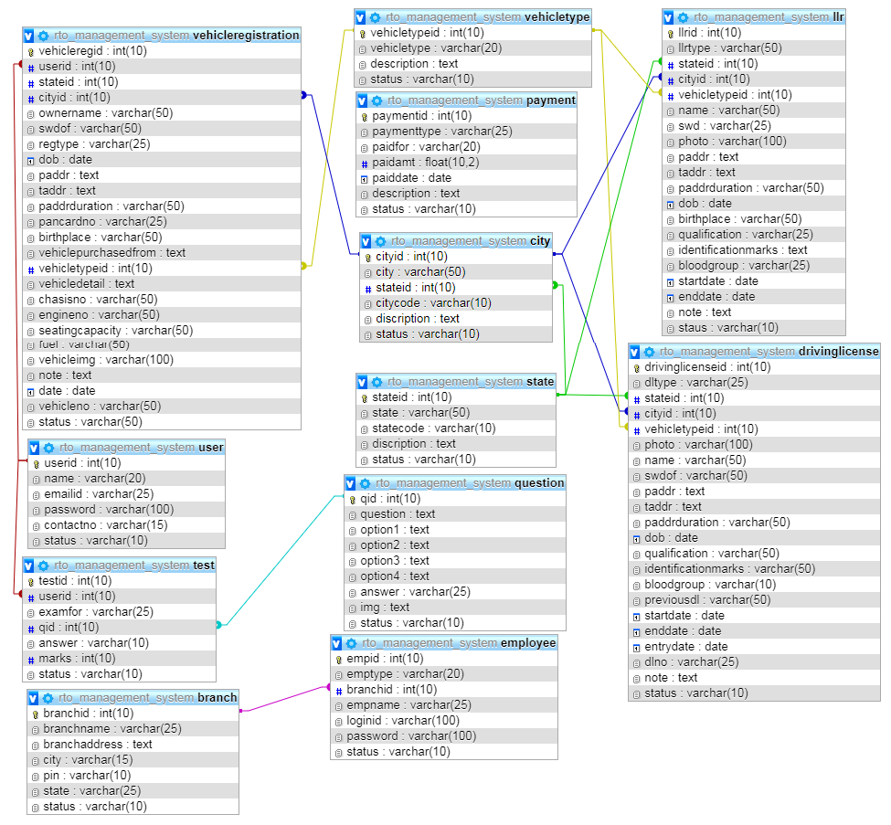
Schema Diagram:

Slide 38
4.Detail Design
4.1. Introduction :
The purpose of preparing this document is to explain complete design details of our RTO_Management_System
This detailed design report will mainly contain the general definition and features of the project, design constraints, the overall system architecture and data architecture. Additionally, a brief explanation about our current progress and schedule of the project will be provided in related sections. Design of the system and subsystems/modules will be explained both verbally and visually by means of diagrams in order to help the programmer to understand all information stated in this document correctly and easily.
4.2. Applicable Documents:
The documents used during detailed design are
System Requirements Document
System Design
Database Design

Slide 39
4.3. Structure of the software package :
The Components are –
4.3.1. Administrator:
Administrator is a super user treated as owner of this site. He can have all the privileges.
Administrator managing completed features of the website. Admin can approve driving license, vehicle registrations, etc. Administrator can add employees for each branches.
4.3.2. Employee:
Employees are working for RTO Company who verifies user profile.
4.3.3. User:
Users are citizens of India who can apply for LLR, permanent license, learner’s License, Renewal of permanent license, Issue of learner’s license

Slide 40
4.4. The project has following modules:
Admin Account module: Administrator is the main user of the project. He has the power to verify the data entered by RTO officials.
RTO officer account module: This module is for RTO officers to manage the user applications. Administrator is adding RTO official details.
User account module: This module allows user to register through online by entering profile details. After the successful registration the user can login to the system by entering login id and password.
Vehicle registration module: The module allows user to apply new registration of vehicles. Even this module allows to send vehicle transfer request.
Online License Application module: This module allows users to apply for Learner license, permanent license, changing the address of license, renew the license. RTO officials can verify and approve/reject received applications.
Branch module: This module allows user to add RTO branch details by entering branch name, branch description, etc.
Report module: This module generates various kinds of reports.

Slide 41
4.. Modular Decomposition of Components:
4.1. Admin Account Component:
4.1.1. Identification of Modules:
The modules identified in this component are:
      Add employees
      View employees
      Add branch
      View branch
      Verification of DL, LLR, Vehicle registration
4.1.2. Structure chart for Admin Account:

Slide 42
4.2. RTO officer account Component:
4.2.1. Identification of Modules:
The modules identified in this component are:
    Registration of vehicle
    Providing number for vehicle
    Issue of information's about driving license.
    Renewal of license
    many more
4.2.2. Structure chart for RTO officer account:

Slide 43
4.3. User Account Component:
4.3.1. Identification of Modules:
The modules identified in this component are:
    User registration module
    User login module
4.3.2. Structure chart for User Account:

Slide 44
4.4. Vehicle Registration Component:
4.4.1. Identification of Modules:
The modules identified in this component are:
    Vehicle registration module
    Vehicle transfer module
4.4.2. Structure chart for Vehicle Registration:

Slide 45
4.5. Online License Application Component:
4.5.1. Identification of Modules:
The modules identified in this component are:
    Learner license module
    Permanent license module
    Address modification module
    License renewal module
4.5.2. Structure chart for Online License Application:

Slide 46
4.6. Branch Component:
4.6.1. Identification of Modules:
The modules identified in this component are:
    Add branch
    View branch
4.6.2. Structure chart for Branch:
PG NO: 25

Slide 47
4.7. Report Component:
4.7.1. Identification of Modules:
The modules identified in this component are:
      Registration report
      Vehicle registration report
      Learner license report
      Permanent license report
      Address modification report
      License renewal report
4.7.2. Structure chart for Report:

Slide 48
            5. DETAIL DESIGN
5.1. RTO Officials
This level used to add RTO official record. First the admin needs to add all state records which stores in state table. Then admin needs to add city table which stores in city table. To add branch record admin needs to select state and city record. After adding branch record branch detail stores in branch table. While adding RTO officials the detail store in employee table. After adding RTO official data, the detail stores in employee table and RTO officials will receive and login credentials of the website.

Slide 49
Structured English
Flow chart to Adding RTO official record:
Name: Inserts state, city, branch, RTO officials.
Process description:
Input data flows: Adding state, branch, city, RTO official record
Output data flows:
State inserted successfully
Branch inserted successfully
City record inserted successfully
RTO official profile inserted successfully
For State:
If(state==valid)
Output: State list inserted successfully
Else
Output: Failed to insert state record...
End If
For City:
If(city==valid)
Output: city list inserted successfully
Else
Output: Failed to insert city record...
End If
For branch:
If(branch==valid)
Output: branch inserted successfully
Else
Output: Failed to insert branch record...
End If
For RTO officials:
if(RTO official == null)
Output: RTO official record inserted successfully..
Else
Output: to insert RTO official record..
End If

Slide 50
5.2.Vehicle Registration
This process explains how the vehicle type detail and vehicle registration detail stores in the database. Admin needs to add vehicle type and those detail stores in vehicletype table. From the customer end customer will apply for new vehicle registration. Entered vehicle detail stores in vehicleregistration table. After filling vehicle registration detail user needs to pay vehicle registration fee. Fee payment detail stores in payment table. Admin will check all the vehicle registration details and he verifies the detail for approval.

Slide 51
Structured English
Flow chart for Vehicle registration:
Name: Adding vehicle type, Applying for New vehicle registration, Vehicle registration payment.
Process description:
Input data flows: Vehicle types, vehicle registration details, vehicle registration payment details
Output data flows:
System inserts different types of vehicle types
System inserts vehicle registration details
System stores payment details
For Vehicle types:
If(vehicle types == added)
Output: Vehicle types inserted successfully
Else
Output: Failed to insert vehicle type
End If
For vehicle registration:
If(vehicle registration details== valid)
Output: Vehicle registration details inserted successfully
Else
Output: Failed to insert Vehicle registration details
End If
For payment record:
If(payment details == valid)
Output: Payment details added successfully
Else
Output: Failed to insert Payment record
End If

Slide 52
5.3. User/Enroller Registration
This module is registration module which helps to register to user/enroller through online. user needs to enter registration details by entering name, Email ID, password, contactno. Registration detail stores in user table. After the registration user can login to the website by entering emailid and password in the login process. The registration detail verifies from user/enroller table.

Slide 53
For enroller registration:
If(registrationdetails==valid)
emailid = Check whether entered email id is valid;
password = Check whether entered password is valid
ConfirmPassword = Check whether password and confirm password is valid
ContactNumber = Check whether contact number is valid
Output: Enroller registration done successfully
Else
Output: Failed to register
End If
For Enroller login:
if(Login credentials == valid)
Output: Logged in successfully..
Else
Output: Kindly enter valid login id and password
End If
Structured English
Flow chart for Enroller registration:
Name: To create enroller registration and login
Process description:
Input data flows: enroller registration detail, Enroller login detail
Output data flows:
Enroller registration detail entered successfully
Enroller logged in successfully

Slide 54
5.4. LLR Application
This process will explain how the Learning license application works in our project. First user needs to apply for learning license. After applying learning license those detail stores in llr table. After entering detail, the user needs to pay for learning license. From the employee end employee needs to take test to approve learning license. The test detail stores in test table. After the test the employee can verify or reject LLR application.

Slide 55
For Driving license:
If(learning license details== valid)
Output: learning license application entry done successfully
Else
Output: Failed to insert learning license application
End If
For payment record:
If(payment details == valid)
Output: Payment details added successfully
Else
Output: Failed to insert Payment record
End If
For test:
If(test == pass)
Output: learning license issued successfully
Else
Output: Failed to issue learning license
End If
Structured English
Flow chart for Learning license registration:
Name: Applying for learning license, Making payment, Conducting test
Process description:
Input data flows: learning license details, Payment details, learning license verification details
Output data flows:
System stores learning license details
System stores payment details
System verifies learning license record and issues learning license.

Slide 56
5.5. Driving License
This process will explain how the Driving license feature works and how user can apply for driving license. First user needs to apply for Driving license and application detail stores in driving­_license table. After entering detail, the user needs to pay for Driving license and payment detail stores in payment table. From the employee end employee needs to take test for driving license. The test detail stores in test table. After the test the employee can verify or reject Driving license application. Admin can issue or reject users driving license application.

Slide 57
Structured English
Flow chart for Driving license registration:
Name: Applying for driving license, Making payment, Conducting test
Process description:
Input data flows: Driving license details, Payment details, Driving license verification details
Output data flows:
System stores Driving license details
System stores payment details
System verifies driving license record and issues driving license.
For Driving license:
If(driving license details== valid)
Output: Driving license application entry done successfully
Else
Output: Failed to insert Driving license application
End If
For payment record:
If(payment details == valid)
Output: Payment details added successfully
Else
Output: Failed to insert Payment record
End If
For test:
If(test == pass)
Output: Driving license issued successfully
Else
Output: Failed to issue Driving license
End If

Slide 58
5.6. Address Modification
This process will explain how to modify permanent address of driving license. First the user needs to enter existing driving license details. After entering existing driving license detail user can apply to modify the address. After applying modification request user needs to pay for it. From the employee end employee will verify and approve/reject the application. Admin will re issue modified driving license to the user.

Slide 59
Structured English
Flow chart for Address modification:
Name: Address modification
Process description:
Input data flows: New address
Output data flows: Address modified
For New address:
if(New address == valid)
Output: Address modified successfully..
Else
Output: Failed to modify address
End If

Slide 60
5.7. License Renewal
This process explains how the license renewal application works online. User needs to apply to renew his existing driving license. After applying the renewal application stores in driving_license table. After applying the user needs pay renewal charge which stores in payment table. Admin will verify the license renewal application and he will verify/reject license renewal document.

Slide 61
Structured English
Flow chart for License renewal:
Name: Applying for license renewal, making payment
Process description:
Input data flows: License renewal detail, Renewal payment detail
Output data flows: System stores learning license application details and payment details.
For Learning license application record:
If(renewal entry == valid)
Output: Learning license record added successfully
Else
Output: Failed to insert Learning license record
End If
For payment record:
If(payment details == valid)
Output: Payment details added successfully
Else
Output: Failed to insert Payment record
End If

Slide 62
6.Conclusion:
The following subsections provide complete overview of the Documentation for the product “RTO Management system”. For the rest of the document, we first define the overall product. Then, we give the external interface requirements, followed by a brief description of the product components and features. In the last section, we have provided the non-functional requirements of the product. This Time we are presenting the Product

Slide 63
The End

Slide 64

THANK YOU MAM

